Slide 1
Working Progress of chosen theses for CSE 596 course.
Theses- Using PLM(Pretrained Language Models) for Toxic Comment Classification
Group 5
Members-
Md. Sayadul Hoque (2235106650)
Moinul Hasan Sifat(2235015650)
Bristy Cathrin(2235366650)
Muntaka Sayef(2235082650)

Slide 2
About Chosen theses
It is a PhD theses.
Datasets links are given but right now those datasets are not available on those link.
Code is not revealed.
Didn’t contact with Author for Datasets and code.

Slide 3
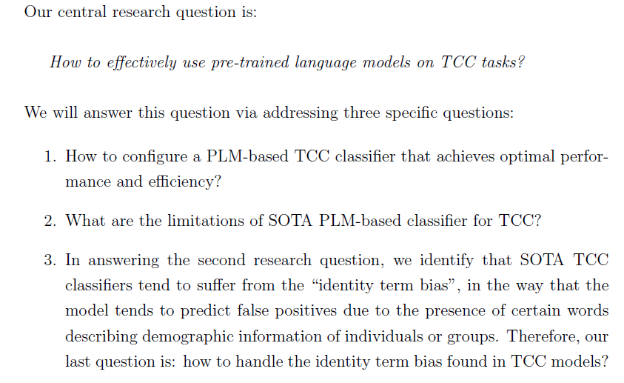
Research Objectives of chosen theses

Slide 4
Our work on chosen theses for this course
We worked on several criteria just like author did in theses with our own effort to find answer of first two research questions. They are:
1. How to configure a PLM-based TCC classifier that achieves optimal performance and efficiency?
2. What are the limitations of SOTA PLM-based classifier for TCC?
But we used one datasets for our work which is kind of same dataset like author used for his work but number of data is not same with those datasets that author used.

Slide 5
Dataset used in Theses
Kumar(15k)
Twitter 18k(18.6K)
Twitter 50K (50.4 K)
Wiki (159.6 K)
Unhealthy comment corpus (35.5 K) – Alhamdulillah worked on it successfully.
Dataset we worked on

Slide 6
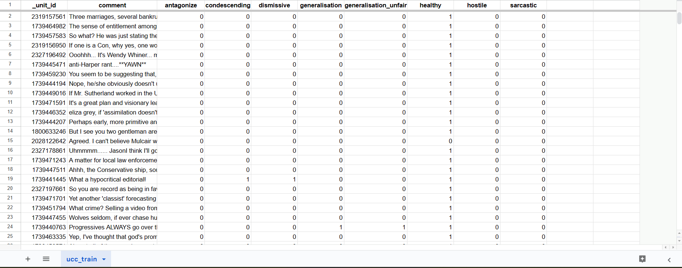
Dataset(UCC)

Slide 7
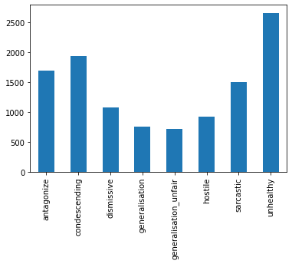
Training Data 1(UCC) Inspection Total row- 35504(Almost 35.5 K)

Slide 8
Attributes & its meaning regrading unhealthy comment
Antagonize: cause (someone) to become hostile or angry.
Condescending: having or showing an attitude of patronizing superiority.
Dismissive: rejecting someone or something.
Generalisation: the action of generalizing.
Generalisation_unfair: not fair category.
Hostile: showing or feeling opposition or dislike.
Sarcastic: marked by or given to using irony in order to mock or convey.
Unhealthy: not good for health.

Slide 9
Usage of Model
In theses
We used
BERT (bert-base-cased): 12 layers, 768 hidden dimensions,12 heads,110 million parameters)
RoBERTa ( roberta-base): 12 layers, 768 hidden dimensions,12 heads,125 million parameters
XLM (xlm-mlm-enfr-1024): 6 layers,1024 hidden dimensions,8 heads,144 million parameters.
BERT (distilbert-base-uncased): 6 layers, 768 hidden dimensions,12 heads,66 million parameters)
RoBERTa ( distilroberta-base): 6 layers, 768 hidden dimensions,12 heads,82 million parameters
XLM (xlm-roberta-base): 12 layers,768 hidden dimensions,8 heads,270 million parameters.

Slide 10
Configuration
In theses
We used
Tokens: 100
Batch size: 16
Learning rate: 5e-5
GPU: Tesla v100-PCIE-32GB
Tokens: 128
Batch size: 64
Learning rate: 1.5e-5
GPU: Tesla T4-16GB

Slide 11
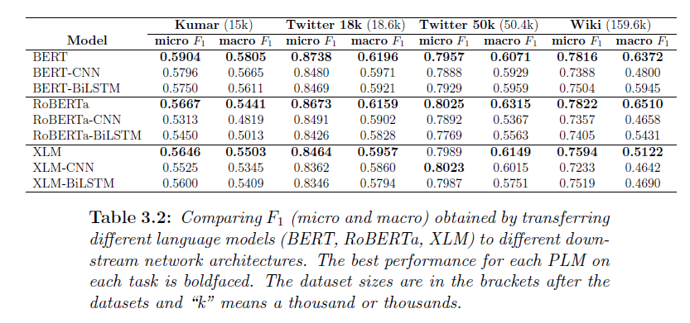
Theses Work about research Question 1

Slide 12
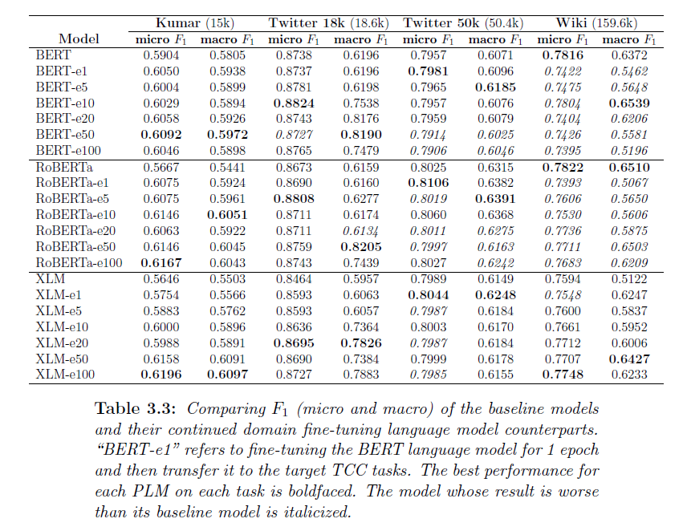

Slide 13
Our Work on Theses Research Question 1

Slide 14
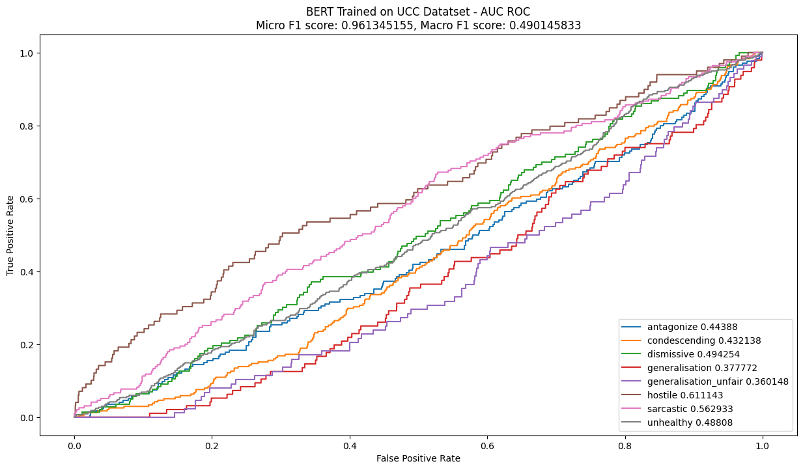
Using BERT for Toxic Comment Classification (UCC dataset) Epoch-1,batch size-64

Slide 15
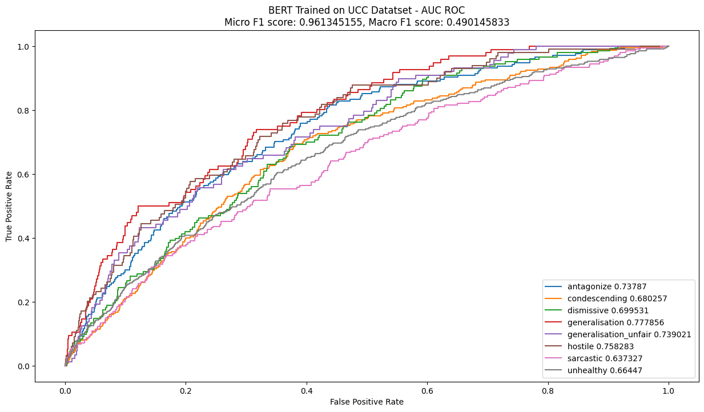
Using BERT for Toxic Comment Classification (UCC dataset) Epoch-5,batch size-64

Slide 16
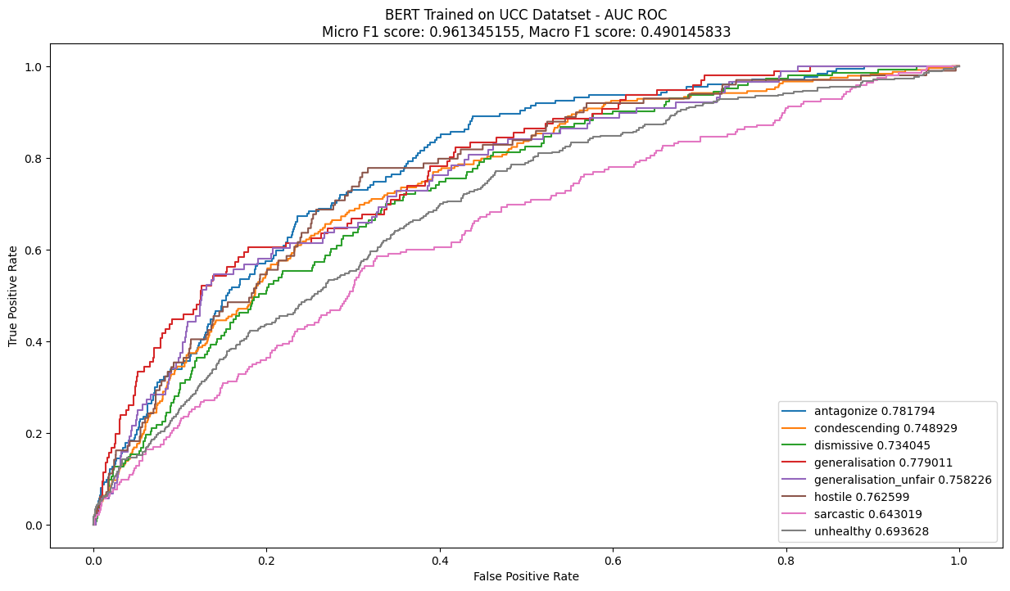
Using BERT for Toxic Comment Classification (UCC dataset) Epoch-10,batch size-64

Slide 17
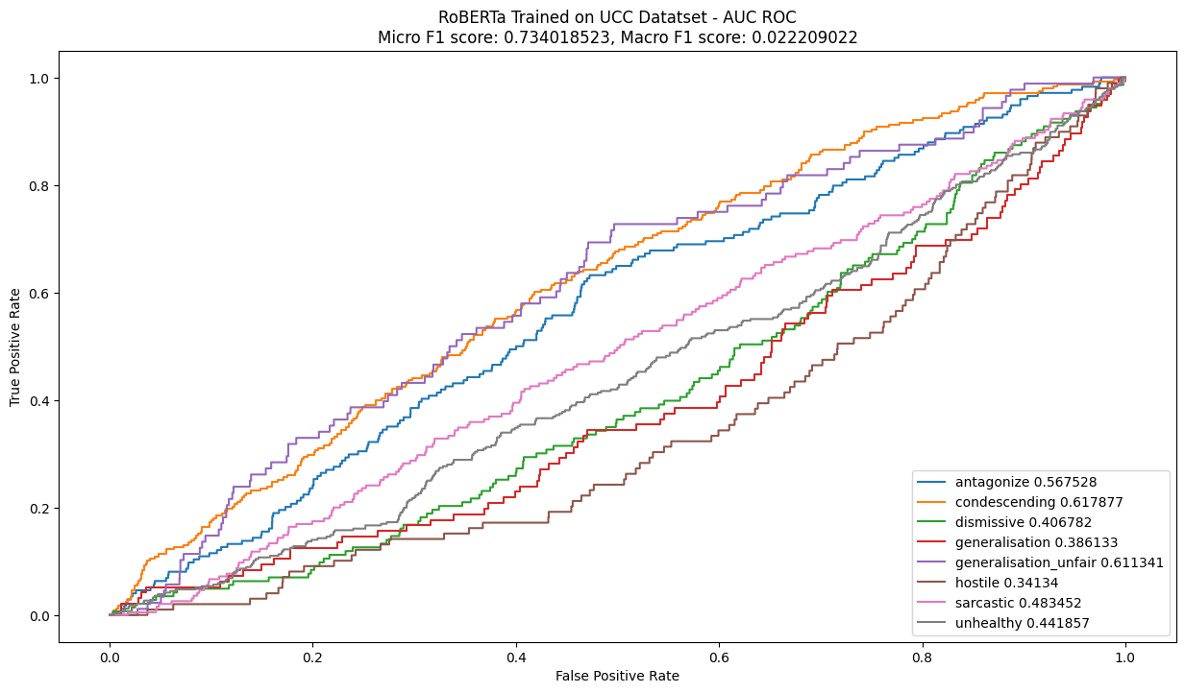
Using RoBERTa for Toxic Comment Classification (UCC dataset) Epoch-1,batch size-64

Slide 18
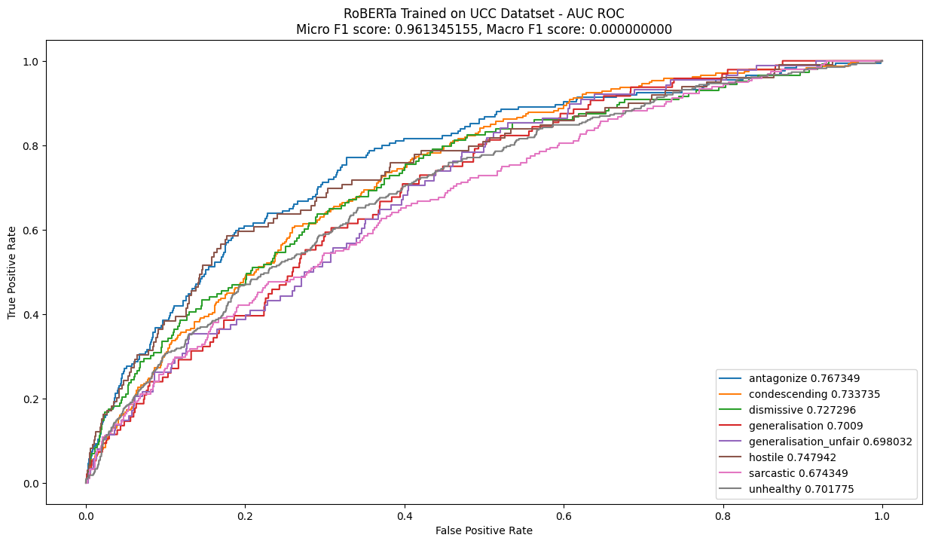
Using RoBERTa for Toxic Comment Classification (UCC dataset) Epoch-5,batch size-64

Slide 19
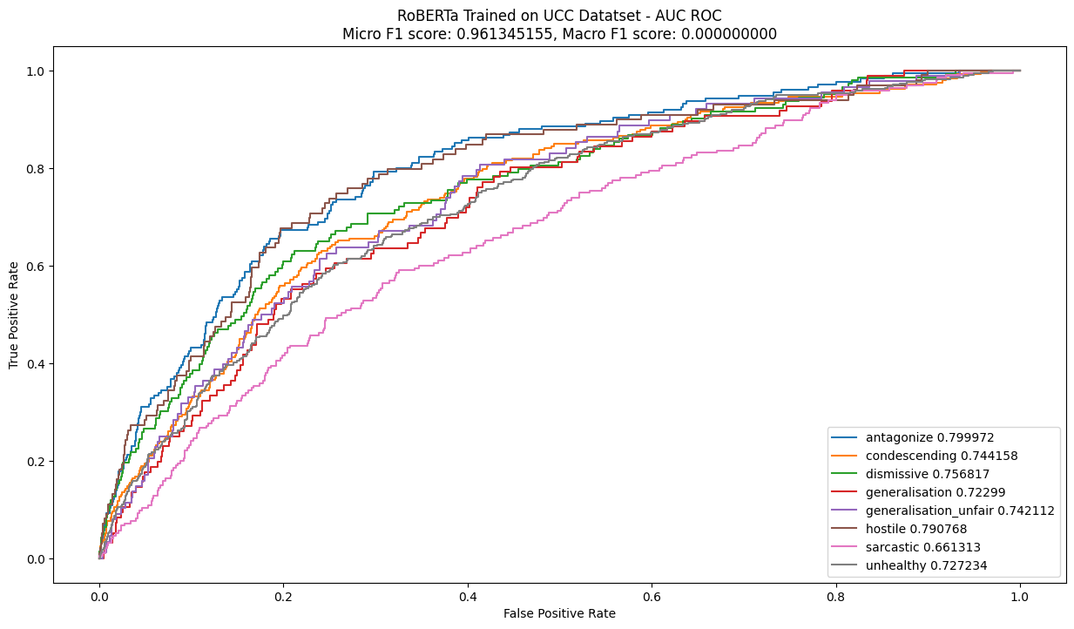
Using RoBERTa for Toxic Comment Classification (UCC dataset) Epoch-10,batch size-64

Slide 20
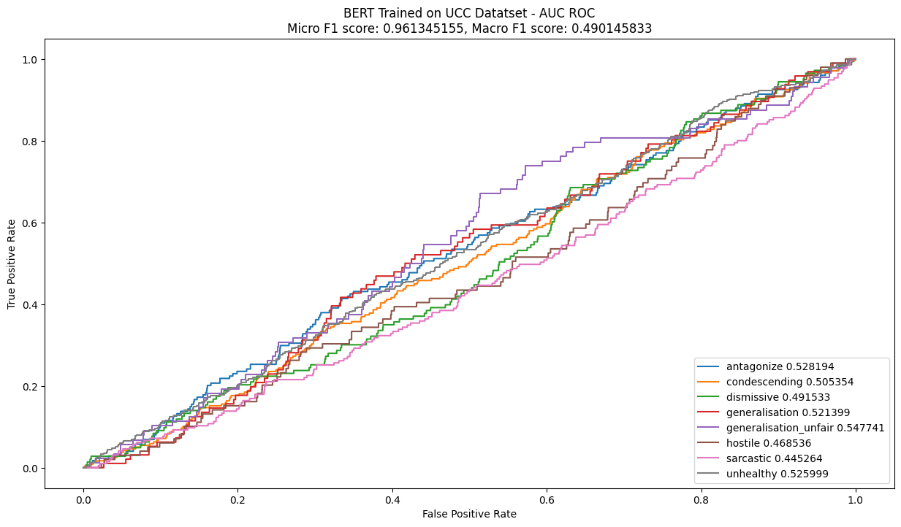
Using XLM for Toxic Comment Classification (UCC dataset) Epoch-1,batch size-64

Slide 21
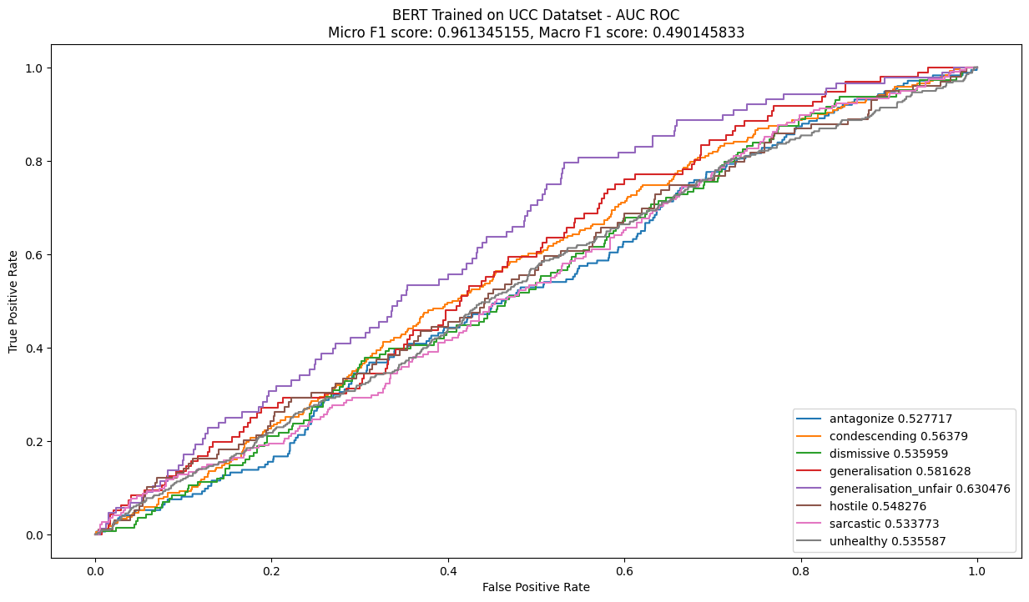
Using XLM for Toxic Comment Classification (UCC dataset) Epoch-5,batch size-64

Slide 22
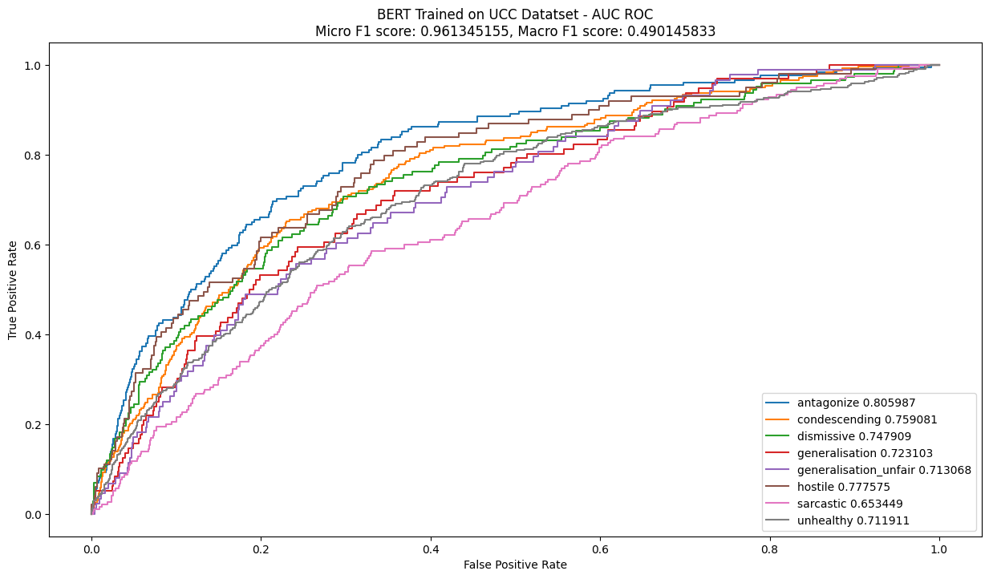
Using XLM for Toxic Comment Classification (UCC dataset) Epoch-10,batch size-64

Slide 23
Observation about Research Question 1
In theses
We got
Continued pretraining particularly benefits small cases of toxic comments in the dataset.
There is no consistent pattern in terms of which epoch setting is the best.
We found that when we increased the epoch number for used models, accuracy got increased.
Though we took results for only 10 epochs maximum, it is expected that after 10 or 20 epochs accuracy won’t increase, it can decrease in some cases.

Slide 24
Observation about Research Question 2
In theses
We got
Experiment results over four datasets have no consistent pattern.
Lack of computational resources.
We worked on only one dataset because of lacking's of computational resources. But there is a possibility that we can also face the same situation.
We also faced that.

Slide 25
Our work for CSE 596
We used a new dataset for our work as datasets are not revealed.
We used a new framework for using those models used in the theses over the dataset we worked on. It was a challenging job as no code was revealed for this theses. And this theses have a very advanced level work for toxic comment classification tasks as it was a Ph.D. research.
We studied Chapter 1-3 of this theses and we gave a presentation on the literature review part of the theses and we tried to practically implement chapter 3 of the theses fully. We also got results of some criteria of Chapter 3.

Slide 26
Our Plan for CSE 597
We will try to work on one more dataset for this research InshaAllah.
We will study Research Question 3 of chosen theses from theses paper and then we will try to work on practically over Research Question 3 following the way the author worked on chosen theses paper InshaAllah.
As the code for this thesis is not revealed, it will be a new and challenging work for us but it will be a learning phase too InshaAllah.

Slide 27
Thank You.

